Slide 1

$$\begin{matrix}\text{Proof}\text{:} \\ \text{let} \\ {\text{t}\text{=}\text{a}}^{\text{x}} \\ \text{by} \text{taking} \text{the} \text{ln} \text{to} \text{both} \text{sides} \\ {\text{lnt}\text{=}\text{lna}}^{\text{x}} \\ \text{lnt}\text{=}\text{xln}\text{(}\text{a}\text{)} \\ {\text{t}\text{=}\text{e}}^{\text{xln}\text{(}\text{a}\text{)}}\end{matrix}$$

Slide 2

$$log_{a}(b)=\frac{\left.ln(b\right)}{\left.ln(a\right)}$$

Slide 4
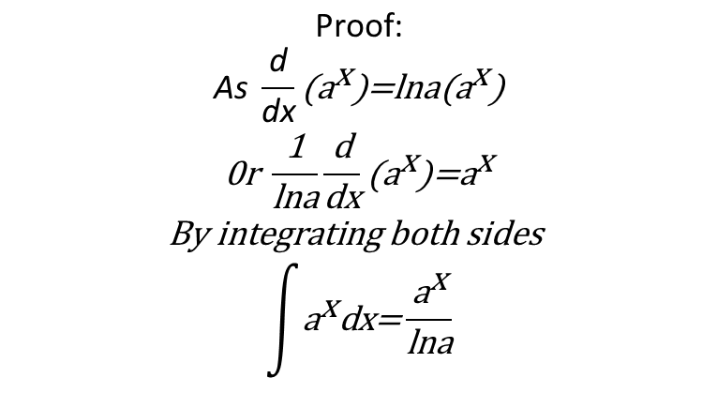
Integration of the exponential function
$$\begin{matrix}\text{Proof}\text{:} \\ \text{As} \frac{\text{d}}{\text{dx}}{\text{(}\text{a}}^{\text{x}}{\text{)=}\text{lna}\text{(}\text{a}}^{\text{x}}\text{)} \\ \text{0}\text{r} \frac{\text{1}}{\text{lna}}\frac{\text{d}}{\text{dx}}{\text{(}\text{a}}^{\text{x}}{\text{)=}\text{a}}^{\text{x}} \\ \text{By} \text{integrating} \text{both} \text{sides} \\ \int{{\text{a}}^{\text{x}}\text{dx}\text{=}\frac{{\text{a}}^{\text{x}}}{\text{lna}}}\end{matrix}$$

